Slide 1
Inventory Management: Drink & delight
Astha
Tanisha Singh
Pulak Sinha
Sagar Sharma
Shivam Tewari
GROUP - C

Slide 2
Epic & user stories
Epic1: Creation of account & Login
Story1: First of all the distributor will open the Login page.
Story2: If the distributor is a new user he will have to create an account, else he will use Login ID & password.
Story3: The Login ID & password will be authenticated by the admin and then access allowed.
Story4: If validation failed user can click on forgot password.

Slide 3
Epic & user stories (contd.)
Epic2: Placing Order & Dispatch
Story1: The system user checks for the availability of products in the inventory and updates the same on the webpage.
Story2: The system user can search for the details of distributor by distributor name and ID.
Story3: The distributor will select the products and quantity and place an order.
Story4: The distributor will be required to provide an address which he can edit or add other address later.
Story5: Once order is placed product order Id would be generated.
Story6: Once order placed the distributor will be able to get the order status by clicking on Track status.
Story7: After order placement system user will update the stocks in the inventory

Slide 4
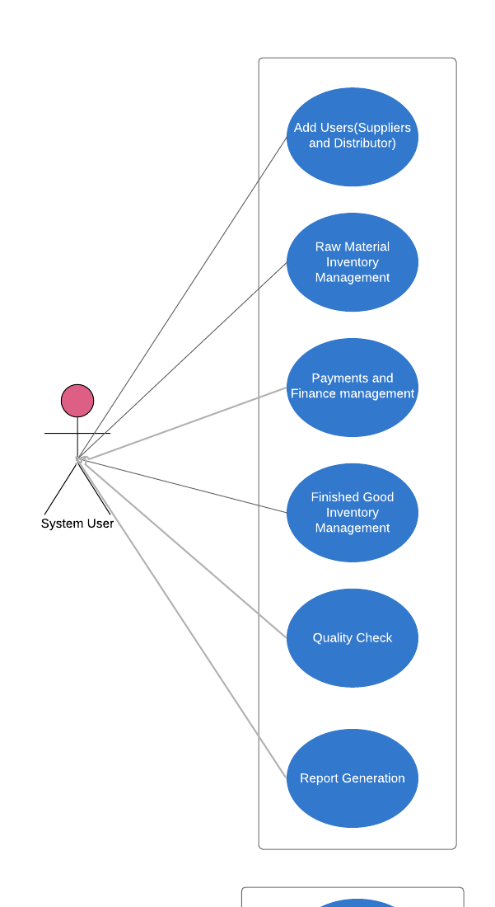
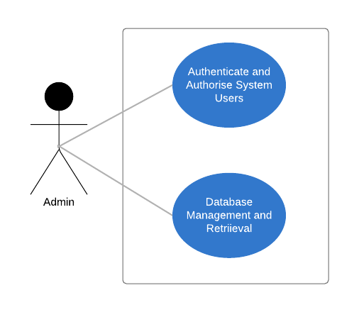
Use Case Diagram

Slide 5
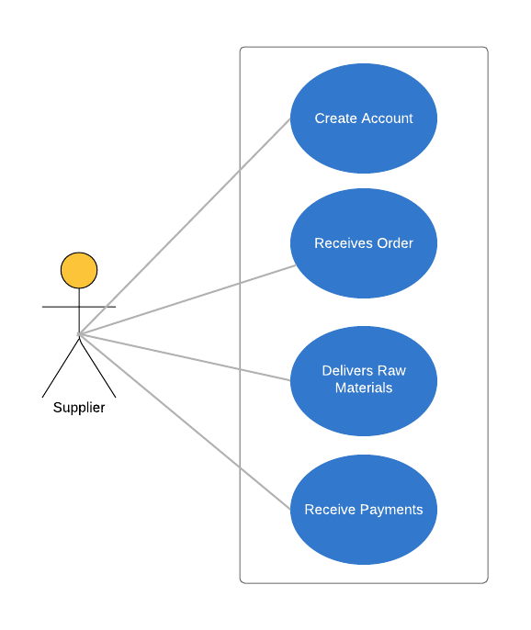
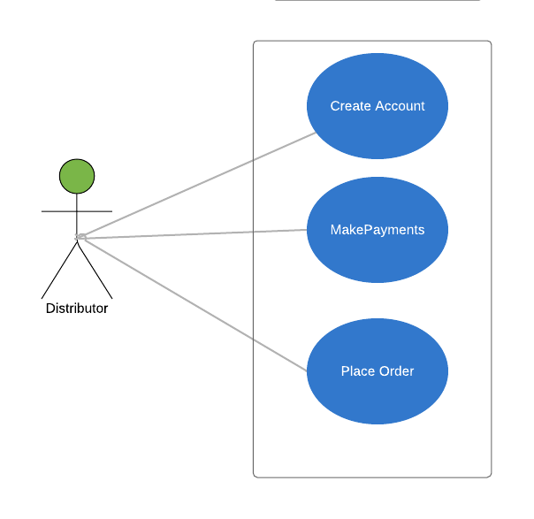
Use Case Diagram

Slide 6
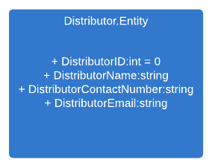
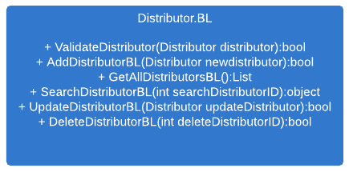
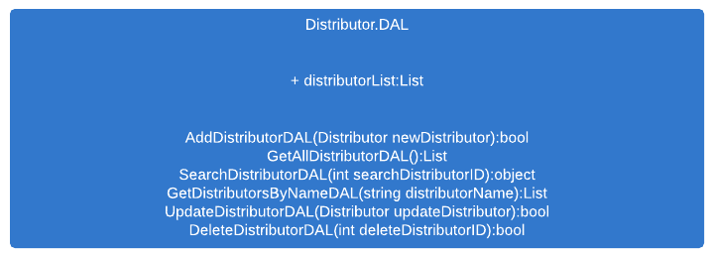
CLASS DIAGRAM FOR DISTRIBUTOR

Slide 7
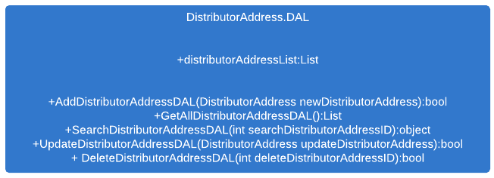
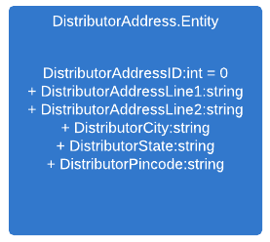
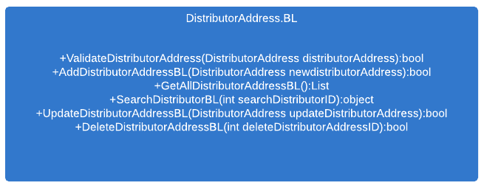
CLASS DIAGRAM FOR DISTRIBUTOR ADDRESS

Slide 8
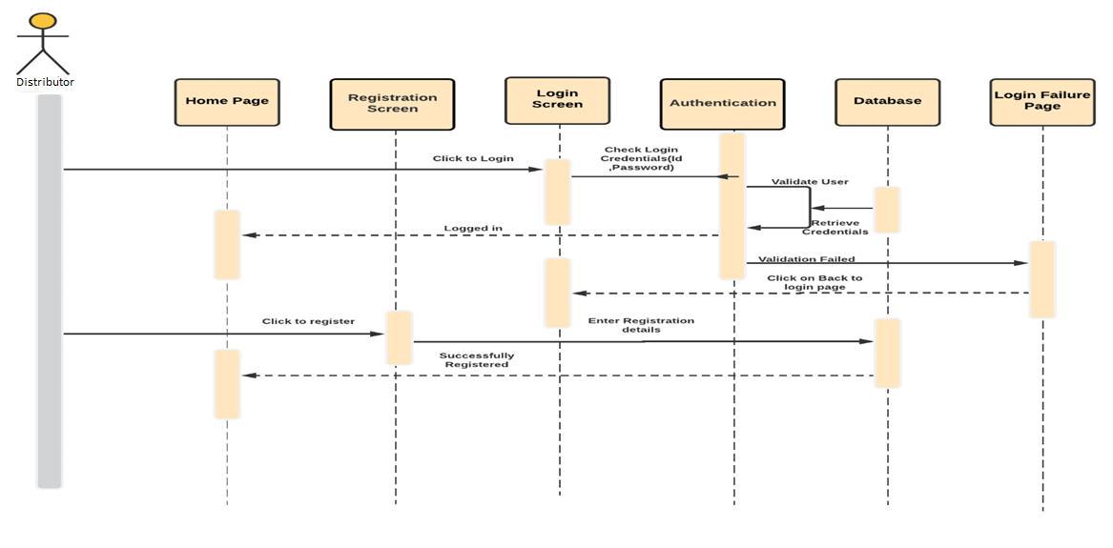
Sequence Diagram for Distributor Login

Slide 9
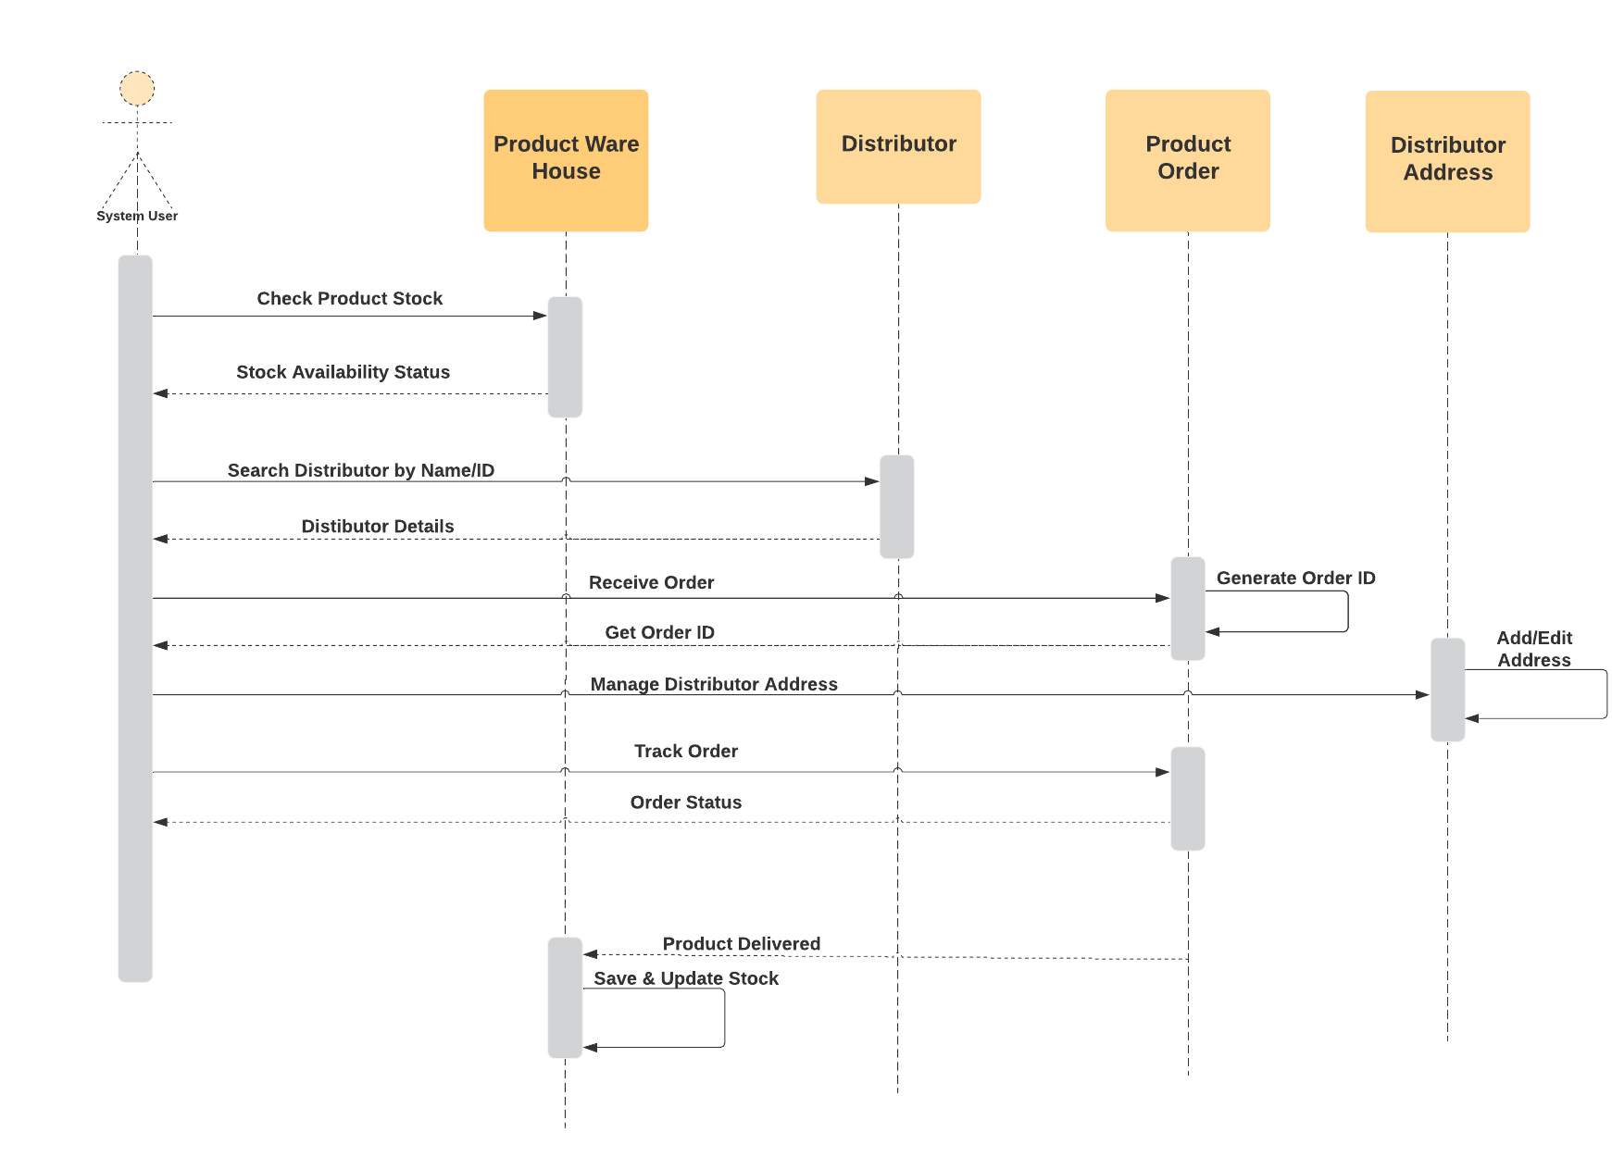
Sequence Diagram for Distributor

Slide 10
Thank You

